Slide 1
Sidecar containers

Slide 2
What are Sidecar Containers
Sidecar containers are the containers that should run along with the main container in the pod. This sidecar pattern extends and enhances the functionality of current containers without changing it.
Imagine that you have the pod with a single container working very well and you want to add some functionality to the current container without touching or changing, how can you add the additional functionality or extending the current functionality

Slide 3
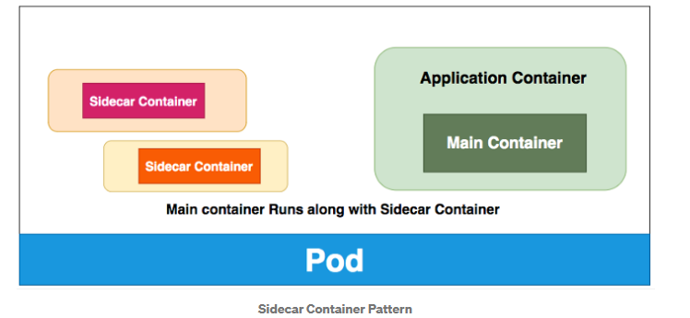
.

Slide 4
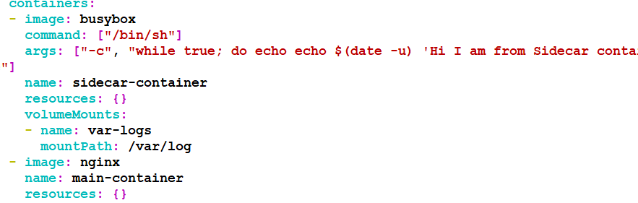
yaml

Slide 5
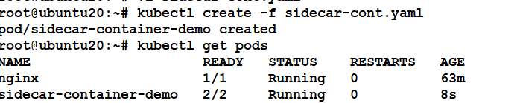
Kubectl cmds

Slide 6
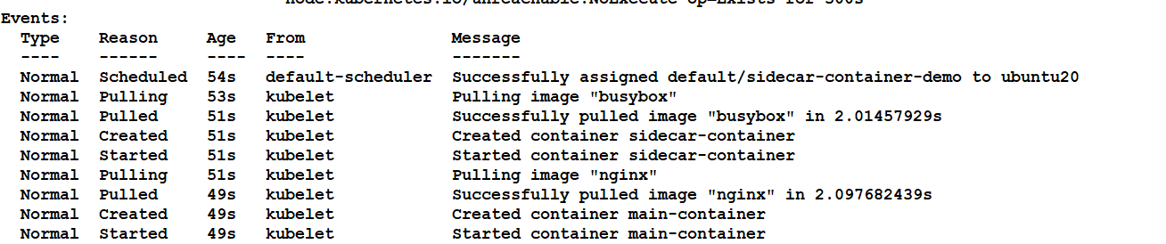
Describe pods

